Slide 1
Secure Systems Engineering Binary Exploitation 1
Chester Rebeiro
Indian Institute of Technology Madras
Notes:
http://security.cs.rpi.edu/courses/binexp-spring2015/lectures

Slide 2
Parts of Malware
Two parts
Subvert execution:
change the normal execution behavior of the program
Payload:
the code which the attacker wants to execute
Execute
payload
Subvert execution
expected flow
of a program

Slide 3

Parts of Malware
Two parts
Subvert execution:
change the normal execution behavior of the program
Payload:
the code which the attacker wants to execute
Malware takes complete control of the process. Has all the privileges that the process has
Execute
payload
Subvert execution
expected flow
of a program

Slide 4
Subvert Execution
In system software
Buffers overflows and overreads
Heap: double free, use after free
Integer overflows
Format string
Control Flow

Slide 5
Buffer Overflows in the Stack
We need to first know how a stack is managed
http://insecure.org/stf/smashstack.html

Slide 6
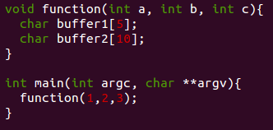
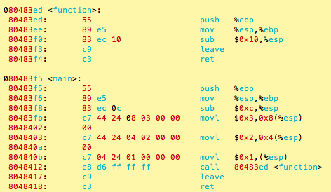
Stack in a Program (when function is executing)
Refer https://chetrebeiro@bitbucket.org/casl/sse.git (directory src/smash)

Slide 7
Stack in a Program (when function is executing)
Stack
esp
esp
Parameters
for function
esp
esp
return Address
esp
prev frame pointer
ebp
Locals of function
esp
In main
In function
Put 3 in stack
Put 2 in stack
Put 1 in stack
push %ebp
parameters
mov %esp, %ebp
%ebp: Frame Pointer
sub $0x10, %esp
%esp : Stack Pointer
call function

Slide 8
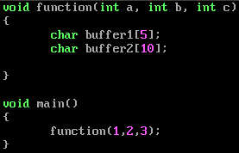
Stack Usage (example)
Stack (top to bottom):
address | stored data
1000 to 997 | 3
996 to 993 | 2
992 to 989 | 1
988 to 985 | return address
984 to 981 | %ebp (stored frame pointer)
(%ebp)980 to 976 | buffer1
975 to 966 | buffer2
(%sp) 964
Parameters
for function
Return Address
frame pointer
prev frame pointer
Locals of function
stack pointer
Notes:
In function.
First push the previous frame pointer (push %ebp)
Create the new frame pointer for this function (movl %esp, %ebp)
Allocate space for the buffers
The minimum size allocated is in multiples of 16
therefore char a[5] will be allocated 16 bytes, char a[9] will be allocated 16 bytes, while char a[17] will be allocated 32 bytes
In main.
note that arguments are pushed in reverse order. First c, then b, then a.
Stack state
TOP:
c
b
a
ret (address to return after function is called)
sfp (the stored frame pointer by pushl %ebp)
buffer1
buffer2

Slide 9
Stack Usage
Stack (top to bottom):
address | stored data
1000 to 997 | 3
996 to 993 | 2
992 to 989 | 1
988 to 985 | return address
984 to 981 | %ebp (stored frame pointer)
(%ebp)980 to 976 | buffer1
975 to 966 | buffer2
(%sp) 964
Legal range of buffer2 is from 975 to 966
However, this assignment will be permitted:
buffer2[10] = ‘a’;
976 → buffer1
A BUFFER OVERFLOW
Notes:
In function.
First push the previous frame pointer (push %ebp)
Create the new frame pointer for this function (movl %esp, %ebp)
Allocate space for the buffers
The minimum size allocated is in multiples of 16
therefore char a[5] will be allocated 16 bytes, char a[9] will be allocated 16 bytes, while char a[17] will be allocated 32 bytes
In main.
note that arguments are pushed in reverse order. First c, then b, then a.
Stack state
TOP:
c
b
a
ret (address to return after function is called)
sfp (the stored frame pointer by pushl %ebp)
buffer1
buffer2

Slide 10
Modifying the Return Address
Stack (top to bottom):
address | stored data
1000 to 997 | 3
996 to 993 | 2
992 to 989 | 1
988 to 985
984 to 981 | %ebp (stored frame pointer)
(%ebp)980 to 976 | buffer1
976 to 966 | buffer2
(%sp) 964
buffer2[19] =
&arbitrary memory location
This causes execution of an arbitrary memory location instead of the standard return
Return Address
Arbitrary Location
19
Execution Subverted
Next step – execute payload!

Slide 11
Big Picture of the exploit (execute an arbitrary payload)
Fill the stack as follows
(where BA is buffer address)
BA
BA
Parameters
for function
BA
BA
BA
Return Address
BA
frame pointer
prev frame pointer
BA
buffer
BA
stack pointer
Exploit code
BA
buffer Address

Slide 12

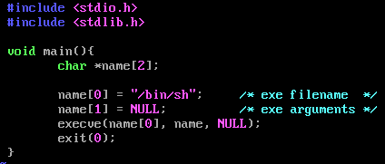
Payload
Lets say the attacker wants to spawn a shell
ie. do as follows:
How does he put this code onto the stack?

Slide 13
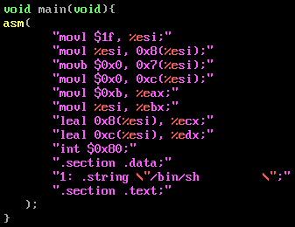
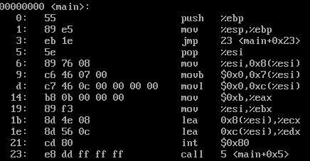
Step 1 : Get machine codes
objdump –disassemble-all shellcode.o
Get machine code : “eb 1e 5e 89 76 08 c6 46 07 00 c7 46 0c 00 00 00 00 b8 0b 00 00 00 89 f3 8d 4e 08 8d 56 0c cd 80 cd 80”
If there are 00s replace it with other instructions

Slide 14
Step 2: Find Buffer overflow in an application
Defined on stack
O
O
O
O
o
Can cause buffer to overflow

Slide 15

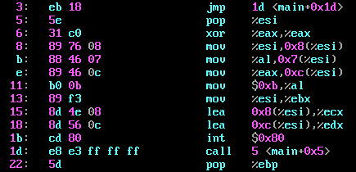
Step 3 : Put Machine Code in Large String
large_string
shellcode

Slide 16
Step 3 (contd) : Fill up Large String with BA
Address of buffer is BA
large_string
shellcode
BA
BA
BA
BA
BA
BA
BA
BA

Slide 17

Final state of Stack
BA
Copy large string into buffer
When strcpy returns the
exploit code would be executed
BA
BA
BA
BA
BA
BA
BA
buffer
shellcode
large_string
shellcode
BA
BA
BA
BA
BA
BA
BA
BA
BA
buffer Address
BA

Slide 18
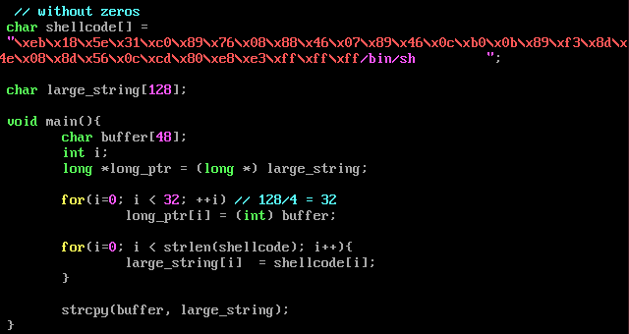
Putting it all together
bash$ ./a.out
$ shell created
Refer https://chetrebeiro@bitbucket.org/casl/sse.git (directory src/smash)

Slide 19
Buffer overflow in the Wild
Worm CODERED … released on 13th July 2001
Infected 3,59,000 computers by 19th July.

Slide 20

CODERED Worm
Targeted a bug in Microsoft’s IIS web server
CODERED’s string
GET /default.ida?NNNNNNNNNNNNNNNNNNNNNNNNN NNNNNNNNNNNNNNNNNNNNNNNNNNNNNNNNNNNN NNNNNNNNNNNNNNNNNNNNNNNNNNNNNNNNNNNN NNNNNNNNNNNNNNNNNNNNNNNNNNNNNNNNNNNN NNNNNNNNNNNNNNNNNNNNNNNNNNNNNNNNNNNN NNNNNNNNNNNNNNNNNNNNNNNNNNNNNNNNNNNN NNNNNNNNNNNNNNNNNNN%u9090%u6858%ucbd3%u7801%u9090%u6858%ucbd3%u7801%u9090%u6858%ucbd3%u7801%u9090%u9090%u8190%u00c3%u0003%u8b00%u531b%u53ff%u0078%u0000%u00=a HTTP/1.0

Slide 21
Some Defense Mechanisms already Incorporated
bash$ gcc overflow1.c
bash$ ./a.out
*** stack smashing detected *** (./a.out terminated)
Aborted (core dumped)
Refer https://chetrebeiro@bitbucket.org/casl/sse.git (directory src/smash)

Slide 22
Some Defense Mechanisms already Incorporated
bash$ gcc -m32 -fno-stack-protector -z execstack overflow1.c
bash$ ./a.out
$ (shell created successfully)
Refer https://chetrebeiro@bitbucket.org/casl/sse.git (directory src/smash)

Slide 23
Defenses
Eliminate program flaws that could lead to subverting of execution
Safer programming languages; Safer libraries; hardware enhancements; static analysis
If can’t eliminate, make it more difficult for malware to subvert execution
W^X , ASLR, canaries
If malware still manages to execute, try to detect its execution at runtime
malware run-time detection techniques using learning techniques, ANN and malware signatures
If can’t detect at runtime, try to restrict what the malware can do..
Sandbox system so that malware affects only part of the system; access control; virtualization; trustzone; SGX
Track information flow
DIFT; ensure malware does not steal sensitive information

Slide 24

Points to Ponder
WHY?
objdump –disassemble-all shellcode.o
Get machine code : “eb 1e 5e 89 76 08 c6 46 07 00 c7 46 0c 00 00 00 00 b8 0b 00 00 00 89 f3 8d 4e 08 8d 56 0c cd 80 cd 80”
If there are 00s replace it with other instructions

Slide 25
Preventing Buffer Overflows with Canaries and W^X

Slide 26

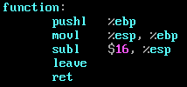
Canaries
Known (pseudo random) values placed on stack to monitor buffer overflows.
A change in the value of the canary indicates a buffer overflow.
Will cause a ‘stack smashing’ to be detected
Stack (top to bottom):
stored data
Function parameters
return address
Frame pointer(%ebp)
Insert canary here
buffer1
buffer2
Insert a canary here
check if the canary value
has got modified

Slide 27
Canaries and gcc
As on gcc 4.4.5, canaries are not added to functions by default
Could cause overheads as they are executed for every function that gets executed
Canaries can be added into the code by –fstack-protector option
If -fstack-protector is specified, canaries will get added based on a gcc heuristic
For example, buffer of size at-least 8 bytes is allocated
Use of string operations such as strcpy, scanf, etc

Slide 28
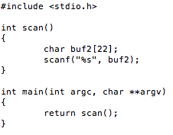
Canaries Example
Stack (top to bottom):
: : : : : : :
return address in main
frame pointer
canary
buffer2

Slide 29

Canaries Example
Stack (top to bottom):
: : : : : : :
32323232
32323232
32323232
32323232 32323232 32323232 32323232 32323232
With canaries, the program gets aborted due to stack smashing.

Slide 30
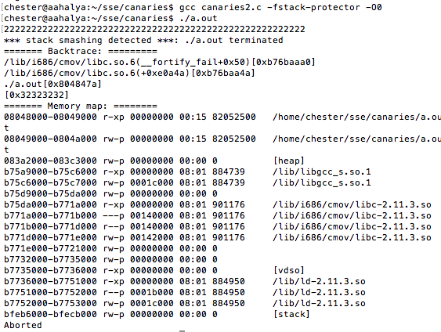
Canaries Example
With canaries, the program gets aborted due to stack smashing.

Slide 31
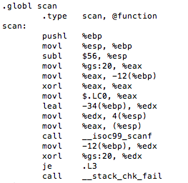
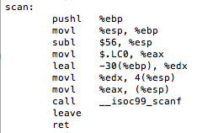
Canary Internals
Store canary onto stack
Verify if the canary has changed
Without canaries
With canaries
gs is a segment that shows thread local data; in this case it is used for picking out canaries

Slide 32
Non Executable Stacks (W^X)
In Intel/AMD processors, ND/NX bit present to mark non code regions as non-executable.
Exception raised when code in a page marked W^X executes
Works for most programs
Supported by Linux kernel from 2004
Supported by Windows XP service pack 1 and Windows Server 2003
Called DEP – Data Execution Prevention
Does not work for some programs that NEED to execute from the stack.
Eg. JIT Compiler, constructs assembly code from external data and then executes it. (Need to disable the W^X bit, to get this to work)

Slide 33
Some Defense Mechanisms already Incorporated
bash$ gcc -m32 -fno-stack-protector -z execstack overflow1.c
bash$ ./a.out
$ (shell created successfully)
Refer https://chetrebeiro@bitbucket.org/casl/sse.git (directory src/smash)

Slide 34
Points to Ponder
What happens to the execution when canaries are not enabled for this program and given the same input below?

Slide 35

Will non executable stack prevent buffer overflow attacks ?
Return – to – LibC Attacks
(Bypassing non-executable stack during exploitation using return-to-libc attacks)
https://css.csail.mit.edu/6.858/2010/readings/return-to-libc.pdf

Slide 36
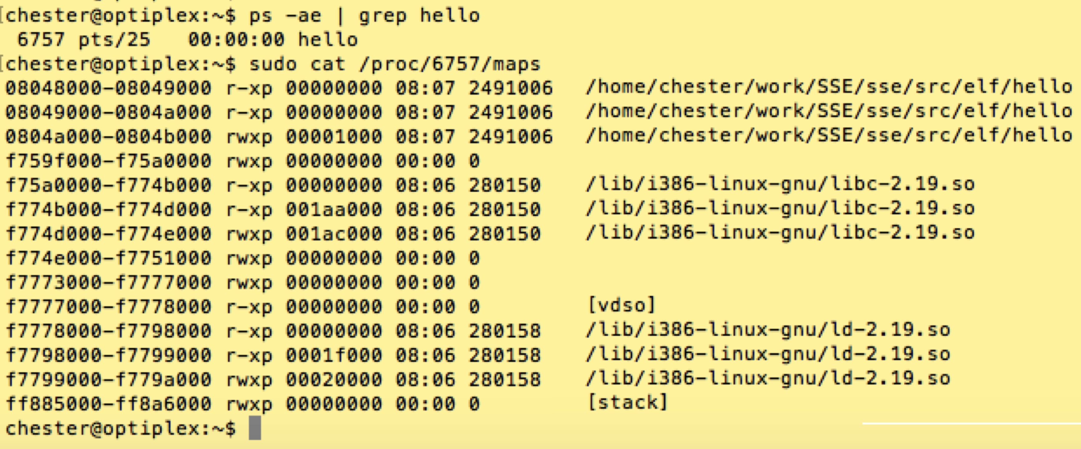
libc

Slide 37
Return to Libc (replace return address to point to a function within libc)
F1 Addr
Stack
Heap
F1 Addr
F1 Addr
F1 Addr
Return Address
F1 Addr
F1 Addr
Data
F1 Addr
F1 Addr
buffer
Text
F1 Addr
Bypasses W^X since F1 is in the code segment,
And can be legally executed.

Slide 38
F1 = system()
One option is function system present in libc
system(“/bin/bash”); would create a bash shell
So we need to
Find the address of system in the program
Supply an address that points to the string /bin/bash

Slide 39
The return-to-libc attack
/bin/bash
string ptr
Return Address
addr(system)
system()
In libc
buffer
stack
Virtual address space

Slide 40
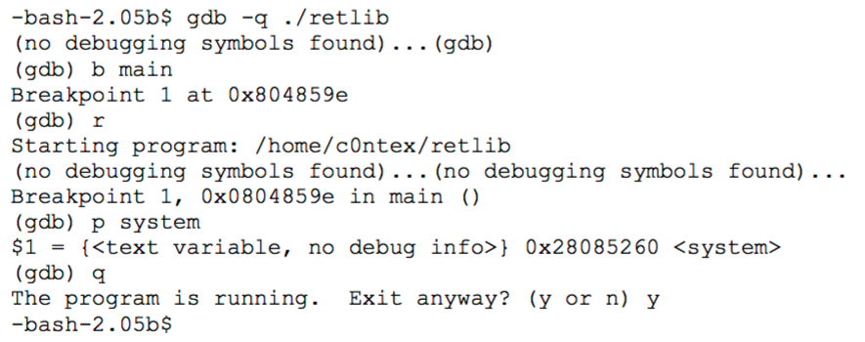
Find address of system in the executable

Slide 41
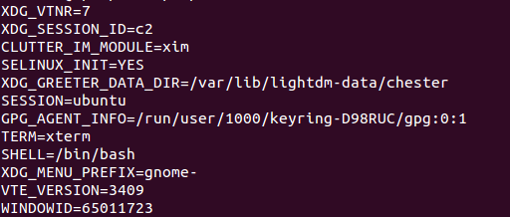
Find address of /bin/bash
Every process stores the enviroment variables at the bottom of the stack
We need to find this and extract the string /bin/bash from it

Slide 42
The final exploit Stack
xxx
xxx
/bin/bash
0xbfbffe25
dead
Return Address
0x28085260
xxx
xxx
system()
In libc
xxx
buffer
xxx
Virtual address space

Slide 43
A clean exit
xxx
xxx
/bin/bash
0xbfbffe25
0x281130d0
exit()
In libc
Return Address
0x28085260
xxx
xxx
system()
In libc
xxx
buffer
xxx
Virtual address space

Slide 44
Limitation of ret2libc
Limitation on what the attacker can do
(only restricted to certain functions in the library)
These functions could be removed from the library

Slide 45
Return Oriented Programming (ROP)

Slide 46
Return Oriented Programming Attacks
Discovered by Hovav Shacham of Stanford University
Subverts execution to libc
As with the regular ret-2-libc, can be used with non executable stacks since the instructions can be legally executed
Unlike ret-2-libc does not require to execute functions in libc (can execute any arbitrary code)
The Geometry of Innocent Flesh on the Bone: Return-into-libc without Function Calls (on the x86)

Slide 47
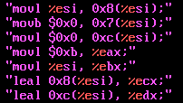
Target Payload
Lets say this is the payload needed to be executed by an attacker.
Suppose there is a function in libc, which has exactly this sequence of instructions … then we are done.. we just need to subvert execution to the function
What if such a function does not exist? If you can’t find it then build it

Slide 48
Step 1: Find Gadgets
Find gadgets
A gadget is a short sequence of instructions followed by a return
Useful instructions : should not transfer control outside the gadget
This is a pre-processing step by statically analyzing the libc library
useful instruction(s)
ret

Slide 49
Step 2: Stitching
Stitch gadgets so that the payload is built
movb $0x0, 0x7(%esi)
ret
G2
movl $0xb, %eax
ret
G4
movb $0x0, 0xc(%esi)
ret
G3
Ret instruction has 2 steps:
Pops the contents pointed to by ESP into EIP
Increment ESP by 4 (32bit machine)
movl %esi, 0x8(%esi)
ret
G1
Program Binary

Slide 50
Step 3: Construct the Stack
xxx
Address of G4
Address of G3
Address of G2
esp
Address of G1
xxx
xxx
xxx
movl %esi, 0x8(%esi)
ret
G1
xxx
Program Binary
Program Stack

Slide 51
Step 3: Construct the Stack
xxx
Address of G4
movb $0x0, 0x7(%esi)
ret
G2
Address of G3
esp
Address of G2
Address of G1
xxx
xxx
xxx
movl %esi, 0x8(%esi)
ret
G1
xxx
Program Binary
Program Stack

Slide 52
Step 3: Construct the Stack
xxx
Address of G4
movb $0x0, 0x7(%esi)
ret
G2
esp
Address of G3
Address of G2
Address of G1
movb $0x0, 0xc(%esi)
ret
G3
xxx
xxx
xxx
movl %esi, 0x8(%esi)
ret
G1
xxx
Program Binary
Program Stack

Slide 53
Step 3: Construct the Stack
xxx
esp
Address of G4
movb $0x0, 0x7(%esi)
ret
G2
Address of G3
Address of G2
movl $0xb, %eax
ret
G4
Address of G1
movb $0x0, 0xc(%esi)
ret
G3
xxx
xxx
xxx
movl %esi, 0x8(%esi)
ret
G1
xxx
Program Binary
Program Stack

Slide 54
Finding Gadgets
Static analysis of libc
To find
A set of instructions that end in a ret (0xc3)
The instructions can be intended (put in by the compiler) or unintended
Besides ret, none of the instructions transfer control out of the gadget

Slide 55
Finding Gadgets
Scan libc from the beginning toward the end
If 0xc3 is found
Start scanning backward
With each byte, ask the question if the subsequence forms a valid instruction
If yes, add as child
If no, go backwards until we reach the maximum instruction length (20 bytes)
Repeat this till (a predefined) length W, which is the max instructions in the gadget
33 | b2 | 23 | 12 | a0 | 31 | a5 | 67 | 22 | ab | ba | 4a | 3c | c3 | ff | ee | ab | 31 | 11 | 09
Found 15,121 nodes in ~1MB of libc binary

Slide 56


Intended vs Unintended Instructions
Intended : machine code intentionally put in by the compiler
Unintended : interpret machine code differently in order to build new instructions
Machine Code :
F7 C7 07 00 00 00 0F 95 45 C3
What the compiler intended..
What was not ntended
Highly likely to find many diverse instructions of this form in x86; not so likely to have such diverse instructions in RISC processors

Slide 57
More about Gadgets
Example Gadgets
Loading a constant into a register (edx ← deadbeef)
pop %edx
ret
deadbeef
esp
GadgetAdd
A previous return will pop the gadget address into %eip
%esp will also be incremented to point to deadbeef (4 bytes on 32 bit platform)
The pop %edx will pop deadbeef from the stack and increment %esp to point to the next 4 bytes on the stack
stack

Slide 58
Stitching Gadgets
G1
pop %edx
ret
G2
G2
addr
esp
G1
mov 64(%edx), %eax
ret
addr
+64
Load arbitrary data into %eax register using
Gadgets G1 and G2
deadbeef
stack

Slide 59
Store Gadget
Store the contents of a register to a memory location in the stack
mov %eax, 24(%edx)
ret
GadgetAddr 2
0
esp
GadgetAddr 1
pop %edx
ret
24
stack

Slide 60
Gadget for addition
Add the memory pointed to by %edx to %eax.
The result is stored in %eax
addl (%edx), %eax
push %edi
ret
pushes %edi.. onto the stack why is this present? …. This is unnecessary, but this is best gadget that we can find for addition
But can create problems!!
We need work arounds!
Modified
GadgetAddr2
esp
GadgetAddr
stack
Some gadget

Slide 61
Gadget for addition (put 0xc3 into %edi)
First put gadget ptr for 0xC3 into %edi
0xC3 corresponds to NOP in ROP
push %edi in gadget 2 just pushes 0xc3 back into the stack Therefore not disturbing the stack contents
Gadget 3 executes as planned
addl (%edx), %eax
push %edi
ret
GadgetAddr3
Gadget_RET
GadgetAddr2
Gadget_RET
0xc3
esp
GadgetAddr1
stack
pop %edi
ret
0xc3 is ret ; in ROP ret is equivalent to NOP v

Slide 62
Unconditional Branch in ROP
Changing the %esp causes unconditional jumps
pop %esp
ret
esp
GA
stack

Slide 63
Tools
Gadgets can do much more… invoke libc functions, invoke system calls, ...
For x86, gadgets are said to be turning complete
Can program just about anything with gadgets
For RISC processors, more difficult to find gadgets
Instructions are fixed width
Therefore can’t find unintentional instructions
Tools available to find gadgets automatically
Eg. ROPGadget (https://github.com/JonathanSalwan/ROPgadget)
Ropper (https://github.com/sashs/Ropper)

Slide 64
Address Space Layout Randomization (ASLR)

Slide 65
The Attacker’s Plan
Find the bug in the source code (for eg. Kernel) that can be exploited
Eyeballing
Noticing something in the patches
Following CVE
Use that bug to insert malicious code to perform something nefarious
Such as getting root privileges in the kernel
Attacker depends upon knowing where these functions reside in memory. Assumes that many systems use the same address mapping. Therefore one exploit may spread easily.

Slide 66
ROP Attack
xxx
esp
Address of G4
movb $0x0, 0x7(%esi)
ret
G2
Address of G3
Address of G2
movl $0xb, %eax
ret
G4
Address of G1
movb $0x0, 0xc(%esi)
ret
G3
xxx
xxx
xxx
movl %esi, 0x8(%esi)
ret
G1
xxx
Program Binary
Program Stack

Slide 67
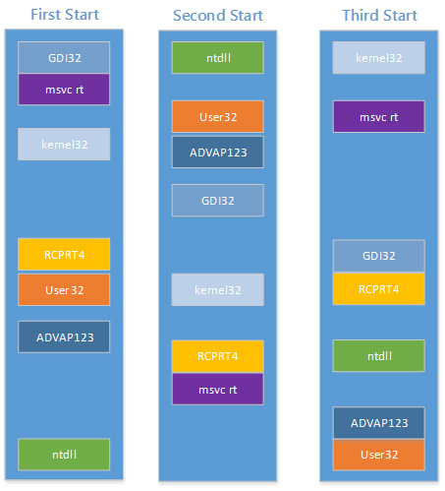
Address Space Randomization
Address space layout randomization (ASLR) randomizes the address space layout of the process
Each execution would have a different memory map, thus making it difficult for the attacker to run exploits
Initiated by Linux PaX project in 2001
Now a default in many operating systems
Memory layout across boots for a Windows box

Slide 68
ASLR in the Linux Kernel
Locations of the base, libraries, heap, and stack can be randomized in a process’ address space
Built into the Linux kernel and controlled by /proc/sys/kernel/randomize_va_space
randomize_va_space can take 3 values 0 : disable ASLR 1 : positions of stack, VDSO, shared memory regions are randomized the data segment is immediately after the executable code
2 : (default setting) setting 1 as well as the data segment location is
randomized
Notes:
The "vDSO" (virtual dynamic shared object) is a small shared library that the kernel automatically maps into the address space of all user-space applications.

Slide 69
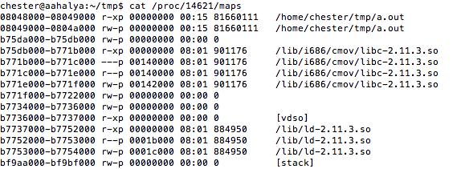
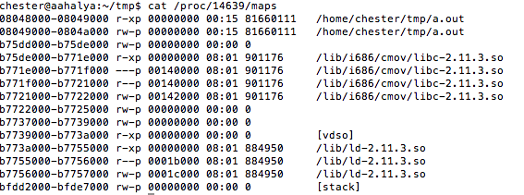
ASLR in Action
First Run
Another Run

Slide 70
ASLR in the Linux Kernel
Permanent changes can be made by editing the /etc/sysctl.conf file
/etc/sysctl.conf, for example:
kernel.randomize_va_space = value
sysctl -p
Notes:
VDSO : ???

Slide 71
Internals : Making code relocatable
Load time relocatable
where the loader modifies a program executable so that all addresses are adjusted properly
Relocatable code
Slow load time since executable code needs to be modified.
Requires a writeable code segment, which could pose problems
PIE : position independent executable
a.k.a PIC (position independent code)
code that executes properly irrespective of its absolute address
Used extensively in shared libraries
Easy to find a location where to load them without overlapping with other modules

Slide 72
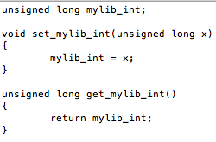

Load Time Relocatable
1
Refer https://chetrebeiro@bitbucket.org/casl/sse.git (directory src/relocgot)

Slide 73
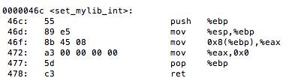
Load Time Relocatable
2
note the 0x0 here… the actual address of mylib_int is not filled in

Slide 74
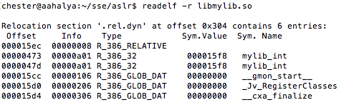
Load Time Relocatable
Relocatable table present in the executable that contains all references of mylib_int
3
Store binary value in the symbol memory location
Offset in memory where the fix needs to be made

Slide 75
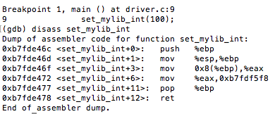
Load Time Relocatable
The loader fills in the actual address of mylib_int at run time.
4

Slide 76
Load Time Relocatable
Limitations
Slow load time since executable code needs to be modified
Requires a writeable code segment, which could pose problems.
Since executable code of each program needs to be customized, it would prevent sharing of code sections

Slide 77
PIC Internals
An additional level of indirection for all global data and function references
Uses a lot of relative addressing schemes and a global offset table (GOT)
For relative addressing,
data loads and stores should not be at absolute addresses but must be relative
Details about PIC and GOT taken from …
http://eli.thegreenplace.net/2011/11/03/position-independent-code-pic-in-shared-libraries/
Notes:
http://eli.thegreenplace.net/2011/11/03/position-independent-code-pic-in-shared-libraries/
https://en.wikipedia.org/wiki/Position-independent_code
https://security.stackexchange.com/questions/58642/how-often-is-aslr-randomness-refreshed-in-linux

Slide 78
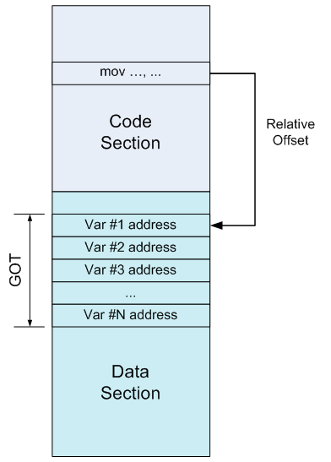

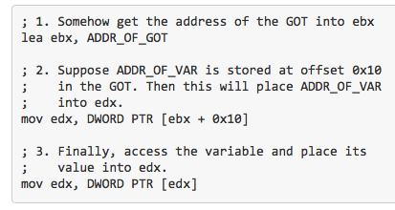
Global Offset Table (GOT)
Table at a fixed (known) location in memory space and known to the linker
Has the location of the absolute address of variables and functions
Without GOT
With GOT

Slide 79
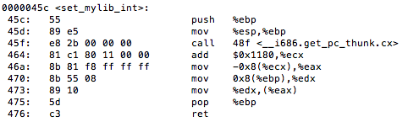

Enforcing Relative Addressing (example)
With load time relocatable
With PIC

Slide 80
Enforcing Relative Addressing (example)
With load time relocatable
With PIC
Get address of next instruction to achieve relativeness
Index into GOT and get the actual address of mylib_int into eax
Now work with the actual address.

Slide 81
Advantage of the GOT
With load time relocatable code, every variable reference would need to be changed
Requires writeable code segments
Huge overheads during load time
Code pages cannot be shared
With GOT, the GOT table needs to be constructed just once during the execution
GOT is in the data segment, which is writeable
Data pages are not shared anyway
Drawback : runtime overheads due to multiple loads

Slide 82

An Example of working with GOT
$gcc –m32 –shared –fpic –S got.c
Besides a.out, this compilation also generates got.s
The assembly code for the program

Slide 83
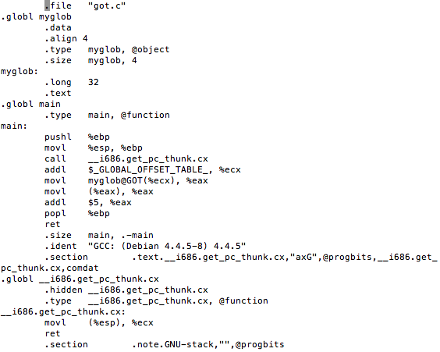
Data section
Text section
The macro for the GOT is known by the linker.
%ecx will now contain the offset to GOT
Load the absolute address of myglob from the GOT into %eax
Fills %ecx with the eip of the next instruction. Why do we need this indirect way of doing this?
In this case what will %ecx contain?
Notes:
First note the various sections
(data and text)… the linker would put this in different locations

Slide 84
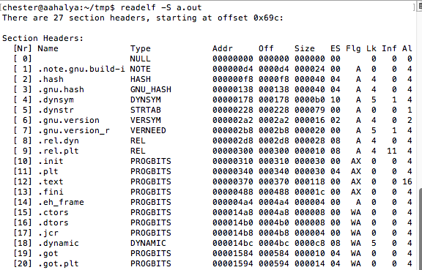
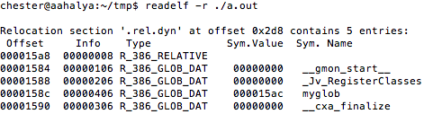
More
offset of myglob in GOT
GOT it!

Slide 85
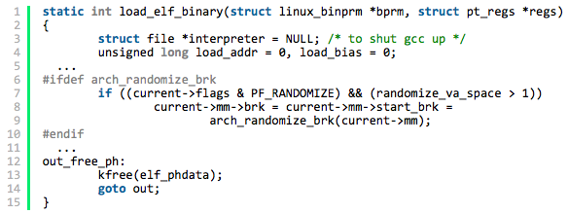

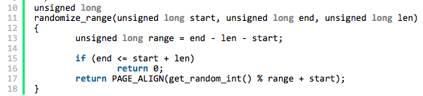
Deep Within the Kernel (randomizing the data section)
loading the executable
Check if randomize_va_space is > 1 (it can be 1 or 2)
Compute the end of the data segment (m->brk + 0x20)
Finally Randomize

Slide 86
Function Calls in PIC
Theoretically could be done similar with the data…
call instruction gets location from GOT entry that is filled in during load time (this process is called binding)
In practice, this is time consuming. Much more functions than global variables. Most functions in libraries are unused
Lazy binding scheme
Delay binding till invocation of the function
Uses a double indirection – PLT – procedure linkage table in addition to GOT

Slide 87
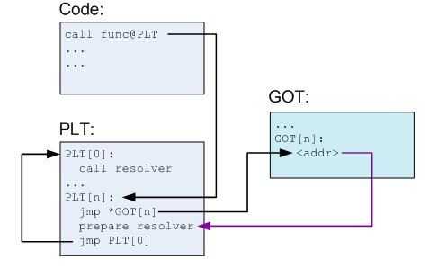
The PLT
Instead of directly calling func, invoke an offset in the PLT instead.
PLT is part of the executable text section, and consists of one entry for each external function the shared library calls.
Each PLT entry has a jump location to a specific GOT entry
Preparation of arguments for a ‘resolver’
Call to resolver function
1

Slide 88
First Invocation of Func
First Invocation of func
(steps 2 and 3)
On first invocation of func, PLT[n] jumps to GOT[n], which simply jumps
back to PLT[n]
1
2
3

Slide 89
First Invocation of Func
(step 4). Invoke resolver, which resolves the actual of func, places this actual address into GOT
and then invokes func
The arguments passed to resolver, that helps to do symbol resolution
Note that the contents of GOT is now changed to point to the actual address of func
1
2
4
3

Slide 90
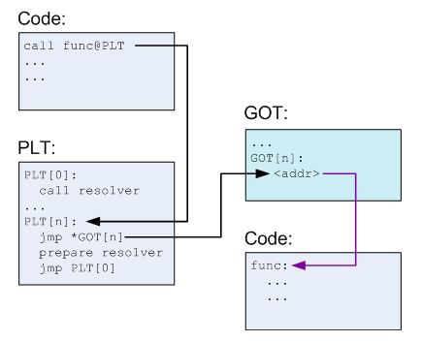
Subsequent invocations of Func
1
3
2

Slide 91
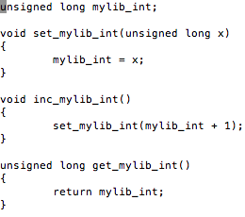

Example of PLT
Refer https://chetrebeiro@bitbucket.org/casl/sse.git (directory src/plt)

Slide 92
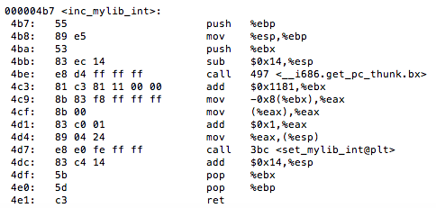
Example of PLT
Compiler converts the call to set_mylib_int into set_mylib_int@plt
Refer https://chetrebeiro@bitbucket.org/casl/sse.git (directory src/plt)

Slide 93
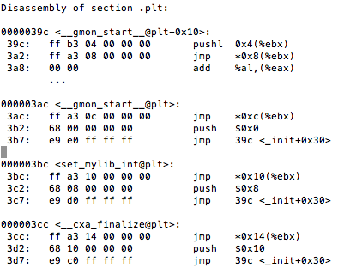

Example of PLT
ebx points to the GOT table ebx + 0x10 is the offset corresponding to set_mylib_int
Offset of set_mylib_int in the GOT (+0x10).
It contains the address of the next instruction (ie. 0x3c2)

Slide 94
Example of PLT
Jump to the resolver, which resolves the actual address of set_mylib_int and fills it into the GOT
Push arguments for the resolver.
Jump to the first entry of the PLT
Ie. PLT[0]

Slide 95
Advantages
Functions are relocatable, therefore good for ASLR
Functions resolved only on need, therefore saves time during the load phase

Slide 96
Bypassing ASLR
Brute force
Return-to-PLT
Overwriting the GOT
Timing Attacks

Slide 97
Safer Programming Languages, and Compiler Techniques

Slide 98
Other Precautions for buffer overflows
Enforce memory safety in programming language
Example java, C# (slow and not feasible for system programming)
Cannot replace C and C++. (Too much software already developed in C / C++)
Newer languages like Rust seem promising
Use securer libraries. For example C11 annex K, gets_s, strcpy_s, strncpy_s, etc.
(_s is for secure)

Slide 99
Compile Bounds Checking
Check accesses to each buffer so that it cannot be beyond the bounds
In C and C++, bound checking performed at pointer calculation time or dereference time.
Requires run-time bound information for each allocated block.
Two methodologies
Object based techniques
Pointer based techniques
Softbound : Highly Compatible and Complete Spatial Memory Safety for C
Santosh Nagarakatte, Jianzhou Zhao, Milo M. K. Martin, and Steve Zdancewic

Slide 100
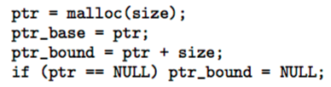
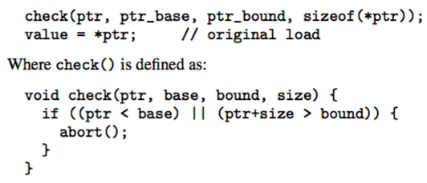
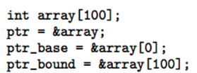
Softbound
Every pointer in the program is associated with a base and bound
Before every pointer dereference to verify to verify if the dereference is legally permitted
These checks are automatically inserted at compile time for all pointer variables. For non-pointers, this check is not required.

Slide 101

Softbound – more details
pointer arithmetic and assignment The new pointer inherits the base and bound of the original pointer
No specific checks are required, until dereferencing is done

Slide 102
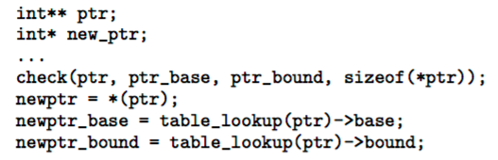
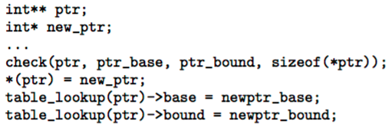
Storing Metadata
Table maintained for metadata

Slide 103
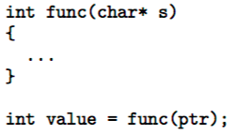
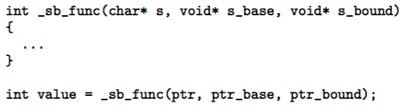
Softbound – more details
Pointers passed to functions
If pointers are passed by the stack no issues. The compiler can put information related to metadata onto the stack
If pointers passed by registers.
Compiler modifies every function declaration to
add more arguments related to metadata
For each function parameter that is a pointer, the corresponding base
and bound values are also sent to the function

